Slide 1
Agenda
Metrics
Test Results
Balance Results
Vissim

Slide 2
Optimisation Performance
Empty network start, subcritical
Rolling start, subcritical
Empty network start, congested
Rolling start, congested
BUT FIRST, try sweeps for
Large Pop, Few Iter VS Small Pop, Many Iter
Random / Geometric / AverageTravelTimes
AlphaBuff mating rights

Slide 3
Optimal Population Size: 60 vs 120
Small Population
Fast iterations
Low diversity
Large Population
Longer iterations
More diversity and more chances to improve by recombination
For a cycle time of 120 s, using maximum bandwidth seed
120 is the minimum number of individuals required to cover the whole search space
At present, each evaluation takes about 1 s

Slide 4
Optimal Population Size: 60 vs 120
Results:
The larger population performs better across the optimization
BUT under time constraints the returns are not large enough to justify the extra computation time

Slide 5
Balance Performance
One hour of Real-Time microsimulation
Balance-optimised timings ran on TRE

Slide 6
Population Seed Methods
The population can be initialised by cloning the geometrical solution, offset by different values and slightly scrambled at the beginning, rather than starting off with completely random solutions.
This improves the initial fitness and progress in the first few generations, but seems to also kill diversity and increase the chance of ending up in a local optimum.

Slide 7
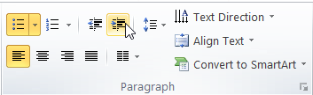

Optimal Population Size
First text layer for running text in 14pt
Second level layer for Headlines in 18pt
Third level layer for bullet points in 14pt
Fourth level layer for bullet points 14pt
Fifth level for numberings 14pt
Sixth level for numberings 14pt
Seventh level for Key Message
Eighth level for Key Message
Ninth text layer for caption, footnotes 8pt
Information
To change from one text layer to the next, use the Increase / Decrease List Level buttons:
Or with your keyboard: ALT+SHIFT+LEFT or RIGHT

Slide 8
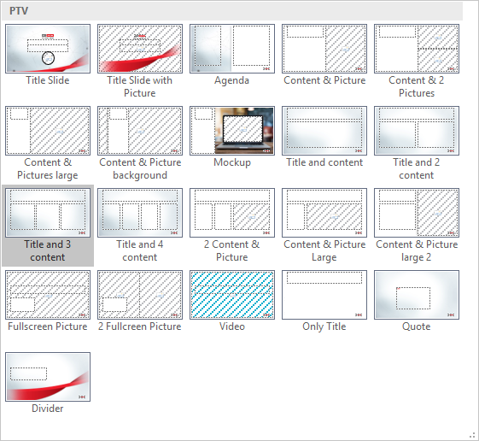
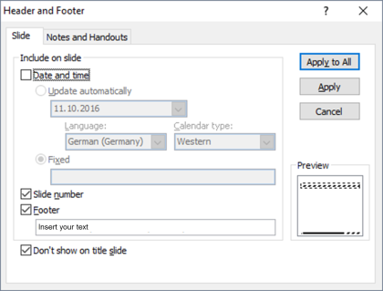
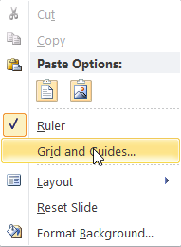
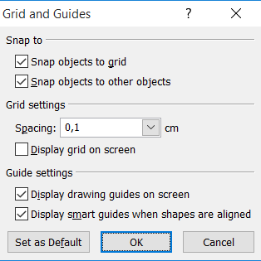
Information
Drawing guides
You can enable your guidelines to align objects on the slide.
Hit the right mouse button outside the slide and go at „Grid and Guides…“
Slide layouts
You can choose between different slide layouts.
Click on the Home-tab | New Slide or Layout | and choose one out of the layouts.
Footer
You can insert or change your presentation‘s footer. Click on the Insert-tab | Header and Footer.
Deactivate Date and Time.

Slide 9
HEADLINE & LOGO
CONTENT
FOOTER / LOGO

